Slide 1
CISC108
Introduction to Computer Science
[Instructor Name]
University of Delaware
Week 2 - Help!

Slide 2
Reminders
Chapter 1 now past due!
Chapter 2 Primer was due today
Chapter 2 Part A due midday through the week
Chapter 2 Part B due this Sunday
Chapter 3 Primer due before next week!
Should be able to schedule your exams now!

Slide 3
Where should you be in the material?
Before coming to class, you should
Finish all the Textbook Work from last week
Finish the Primer for this week’s chapter
Since this is week 2, we will be forgiving…
But next week, class may start with questions answered in the Primer!
Notes:
This is also available as a PE question, if you want to find out whether they said they did. You can check who’s actually opened it via BlockPy later…

Slide 4
Warm-up
Imagine that a classmate posted the following on the Discord:
“I’m trying to add together two numbers, but it’s not working. Can you help me?”
How would you respond?
Notes:
This is a Poll Everywhere question. If you have time at the end, you might actually ask it a second time!

Slide 5
Everybody needs help sometimes.
Nobody knows everything.
You MUST learn how to seek help!

Slide 6
Where to get help in this course
Cohort TA:
Their job is literally to help YOU
Cohort-mates:
11 other students recommended to help you
Office Hours
Dozens of TAs, almost always someone who can help
Discord
Someone is ALWAYS online

Slide 7
SO MUCH WASTED TIME
Student: “Help! I have a problem!”
TA: “Okay, what’s wrong?”
Student: “My code isn’t working.”
TA: “Okay, what is it supposed to be doing?”
Student: “Print a string.”
TA: “Okay, what is it doing instead?”
Student: “Printing a number.”
TA: “Okay, what have you tried so far?”
...

Slide 8
When asking for help, provide these!!!
1
What were you trying to do?
2
What did you expect to happen?
3
What happened instead?
4
What have you tried so far?
Be clear
Mention assignment
Explain why
This step is crucial!!
Share the actual error message
Share the actual code you’ve used

Slide 9
Think critically…
What kind of trouble do you have?
The Problem
The Instructions
The Solution
Do you understand the problem?
Have you read all the instructions?
Can you describe the solution?
The Details
Debugging
Being a human
Do you not know how to do a specific part of your solution?
Do you have a solution, but it has an error?
Do you feel overwhelmed or not know how to get started?

Slide 10
We’re not going to just give you the answer!
Our goal is to help you learn, not to solve problems.

Slide 11
Words matter
Proper spelling, punctuation, and grammar are expected
You should be kind to those who are helping you.
Also be kind to yourself!

Slide 12
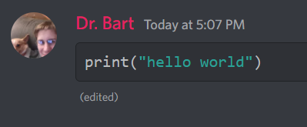
Pro-tip: Sharing Code on Discord
```python
print(“hello world”)
```
Putting three backticks (top-left of keyboard),
The lowercase word “python” without quotes
And then three more backticks on their own line…
Will cause your code to be colored correctly!

Slide 13
BUT WAIT!
Don’t share code for graded assignments!
We already have access to all your BlockPy code. Just tell us which problem you are working on!

Slide 14
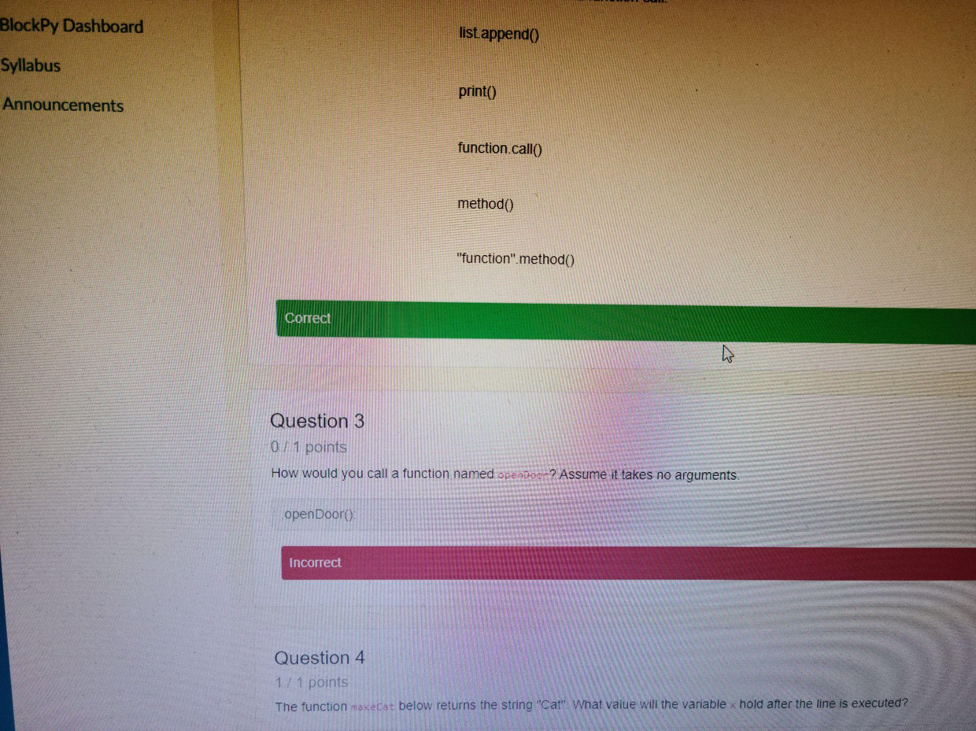
Pro-tip: Take a screenshot, not a photo
Do not take photos of your screen with a phone.
We cannot read it!
Much better to copy/paste text (and use backticks).
But if you want to take a screenshot, follow the instructions we gave you for the Thonny Installation assignment.
https://www.take-a-screenshot.org/

Slide 15

Seeking Help Worksheet
Going to work in groups of 3
First person to open assignment:
Make a copy of the worksheet
Immediately share it with group mates
Everyone needs to put email in the top area in order to receive credit on Canvas
Only one person submits when done
We will review the answers here in class in about 15 minutes.
Start working!

Slide 16
Reviewing Answers
Open up the question list and review the questions with students. Type up a class answer.
https://acbart.github.io/random_prompt.html?question=108scenariosf21&n=22

Slide 17
Debugging skills that don’t require other people

Slide 18
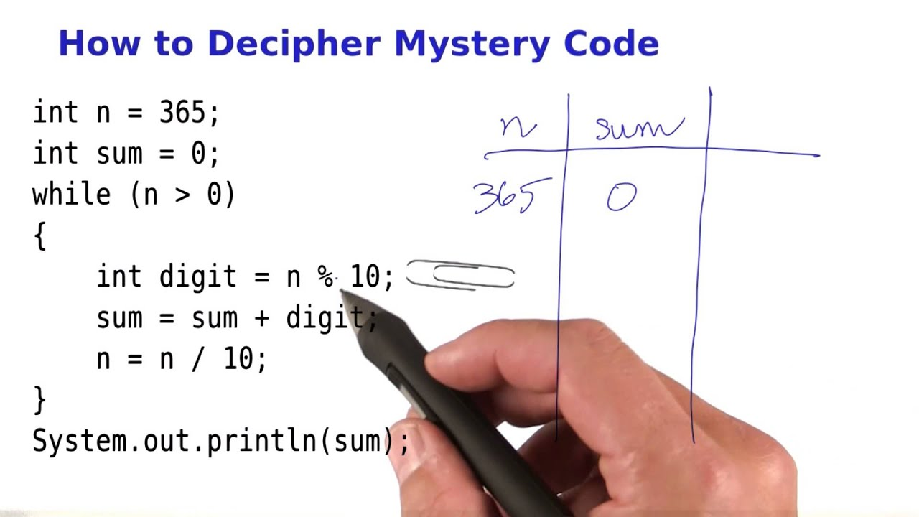
Tracing
Following a program step-by-step, writing down values on a piece of paper.
When a variable’s value changes, cross out the old value.

Slide 19

Thonny’s Debugger
Powerful tool for stepping through code.
Predict the next step of your code before you use the button!

Slide 20
Reading
Have you read the instructions?
Seriously, try reading them out loud.
You might have missed something!

Slide 21
CISC108
Have a great day!
Don’t forget:
You MUST read the Chapter 3 Primer before next lecture!
Chapter 2 material is due this Sunday!
Schedule your exams!
See ya!

